Slide 1
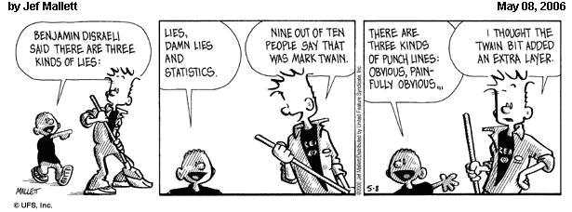
Stats for Computer Science Experiments

Slide 2
Median
Mean
Performance
Alg 1
Alg 2
Parameter estimates or algorithm comparisons without realistic error bars are nearly useless. As a reviewer call people on it.. as an author expect reviewers to call you on it.

Slide 3
Always take the standard error into account when quoting summary statistics. Quoting a silly number of decimal places/significant figures is a sure indicator of statistical and/or scientific illiteracy.
mean of 10 runs of a program on single input with times 3.01, 3.10 … 3.19, 3.23
don’t report run time of 3.14159
Report 3.1 ± .05 (where .05 is standard deviation),

Slide 4
Why Statistics
Almost all experimental CS of interest involves noisy data.
Need to separate our hypothesized meaningful variations from random variations caused by noise.
Ideally, we want to show the difference in performance is statistically significant

Slide 5
Experimental Hypothesis
Any scientific research should state a hypothesis, then
Provide evidence for/against
Conclude whether it is supported or refuted
Should be:
Precise, explicit statement
Falsifiable
Run experiment to confirm or refute
Ensure that the experiment really tests the hypothesis
Notes:
From greek “foundation” - a proposition made as a basis for reasoning without the assumption of its truth

Slide 6
Elaborating the Hypothesis
Hypothesis might be that system/theory/technique/ parameter P is:
Good for task X
Better than rivals Q and R for task X
According to:
Behavior - correctness or quality of solution
Coverage - range of problems to which it applies
Efficiency - resources consumed
Evidence can be theoretical, experimental or both
Theoretical evidence - theorem based
Experimental evidence – statistical testing on data

Slide 7
Nonstatistical Hypothesis Testing…
A criminal trial is an example of hypothesis testing without the statistics.
In a trial a jury must decide between two hypotheses. The null hypothesis is
H₀: The defendant is innocent
The alternative hypothesis or research hypothesis is
H₁: The defendant is guilty
The jury does not know which hypothesis is true. They must make a decision on the basis of evidence presented.

Slide 8
Nonstatistical Hypothesis Testing…
In the language of statistics convicting the defendant is called rejecting the null hypothesis in favor of the alternative hypothesis. That is, the jury is saying that there is enough evidence to conclude that the defendant is guilty (i.e., there is enough evidence to support the alternative hypothesis).
If the jury acquits it is stating that there is not enough evidence to support the alternative hypothesis. Notice that the jury is not saying that the defendant is innocent, only that there is not enough evidence to support the alternative hypothesis.

Slide 9
Nonstatistical Hypothesis Testing…
There are two possible errors.
A Type I error occurs when we reject a true null hypothesis. That is, a Type I error occurs when the jury convicts an innocent person. We would want the probability of this type of error [maybe 0.001 – beyond a reasonable doubt] to be very small for a criminal trial where a conviction results in the death penalty, whereas for a civil trial, where conviction might result in someone having to “pay for damages to a wrecked auto”,we would be willing for the probability to be larger [0.49 – preponderance of the evidence ]
P(Type I error) = α [usually 0.05 or 0.01]

Slide 10
Nonstatistical Hypothesis Testing…
A Type II error occurs when we don’t reject a false null hypothesis. That occurs when a guilty defendant is acquitted.
While less critical in law, in experiments this type of error is by far the most serious mistake we normally make. For example, if we test the hypothesis that the amount of medication in a heart pill is equal to a value which will safely cure your heart problem and “accept” the null hypothesis that the amount is ok. Later on we find out that the average amount is WAY too large and people die from “too much medication” [I wish we had rejected the hypothesis and threw the pills in the trash can], it’s too late because we shipped the pills to the public.

Slide 11
Nonstatistical Hypothesis Testing…
The probability of a Type I error is denoted as α (Greek letter alpha). The probability of a type II error is β (Greek letter beta).
The two probabilities are inversely related -- for a fixed sample size, decreasing one increases the other.
In other words, you can’t force α and β to both be real small for any given sample size. You may have to take a much larger sample size, or in the court example, you need much more evidence.

Slide 12
Hypothesis Testing…
The critical concepts are theses:
1. There are two hypotheses, the null and the alternative hypotheses.
2. The procedure begins with the assumption that the null hypothesis is true.
3. The goal is to determine whether there is enough evidence to infer that the alternative hypothesis is true, or the null is not likely to be true.
4. There are two possible decisions:
Conclude that there is enough evidence to support the alternative hypothesis. Reject the null.
Conclude that there is not enough evidence to support the alternative hypothesis. Fail to reject the null.

Slide 13
Concepts of Hypothesis Testing (1)…
The two hypotheses are called the null hypothesis and the other the alternative or research hypothesis. The usual notation is:
H₀: — the ‘null’ hypothesis
H₁: — the ‘alternative’ or ‘research’ hypothesis
The null hypothesis (H₀) will always state that the parameter equals the value specified in the alternative hypothesis (H₁)
pronounced
H “nought”

Slide 14
Concepts of Hypothesis Testing (4)…
The two possible decisions that can be made:
Conclude that there is enough evidence to support the alternative hypothesis
(also stated as: reject the null hypothesis in favor of the alternative)
Conclude that there is not enough evidence to support the alternative hypothesis
(also stated as: failing to reject the null hypothesis in favor of the alternative)
NOTE: we do not say that we accept the null hypothesis especially if a statistician is around…

Slide 15
Statistical Hypothesis testing
Tests of statistical significance assuming some model of and random noise
Data not consistent with H₀ :
H₀ can be rejected in favour of some alternative hypothesis H₁ (the objective of our study).
Data are consistent with the H₀ :
H₀ cannot be rejected
You cannot say that the H₀ is true.
You can only decide to reject it or not reject it.

Slide 16
p value
p value = probability that our result (e.g. a difference between proportions or a RR) or more extreme values could be observed under the null hypothesis
H₀ rejected using reported p value

Slide 17
p values – practicalities
Low p values = low degree of compatibility between H₀ and the observed data:
→association unlikely to be by chance
→you reject H₀, the test is significant
High p values = high degree of compatibility between H₀ and the observed data:
→association likely to be by chance
→you don’t reject H₀, the test is not significant

Slide 18
Levels of significance – practicalities
We need of a cut-off !
1% 5% 10%
p value > 0.05 = H₀ not rejected (non significant)
p value ≤ 0.05 = H₀ rejected (significant)
BUT:
Better to give the p-value rather than “significant“
vs. “non-significant“.

Slide 19
Examples from the literature
”The limit for statistical significance was set at p=0.05.”
”There was a strong relationship (p<0.001).”
”…, but it did not reach statistical significance (ns).”
„ The relationship was statistically significant (p=0.0361)”
p=0.05 → Agreed convention
Not an absolute truth
”Surely, God loves the 0.06 nearly as much
as the 0.05” (Rosnow and Rosenthal, 1991)

Slide 20
p = 0.05 and its errors
Level of significance, usually p = 0.05
p value used for decision making
But still 2 possible errors:
H₀ should not be rejected, but it was rejected :
→Type I or alpha error
H₀ should be rejected, but it was not rejected :
→Type II or beta error

Slide 21
Types of errors
Truth
No diff
Diff
Decision based on the p value
No diff
Diff
H₀ is “true” but rejected: Type I or α error
H₀ is “false” but not rejected: Type II or β error

Slide 22
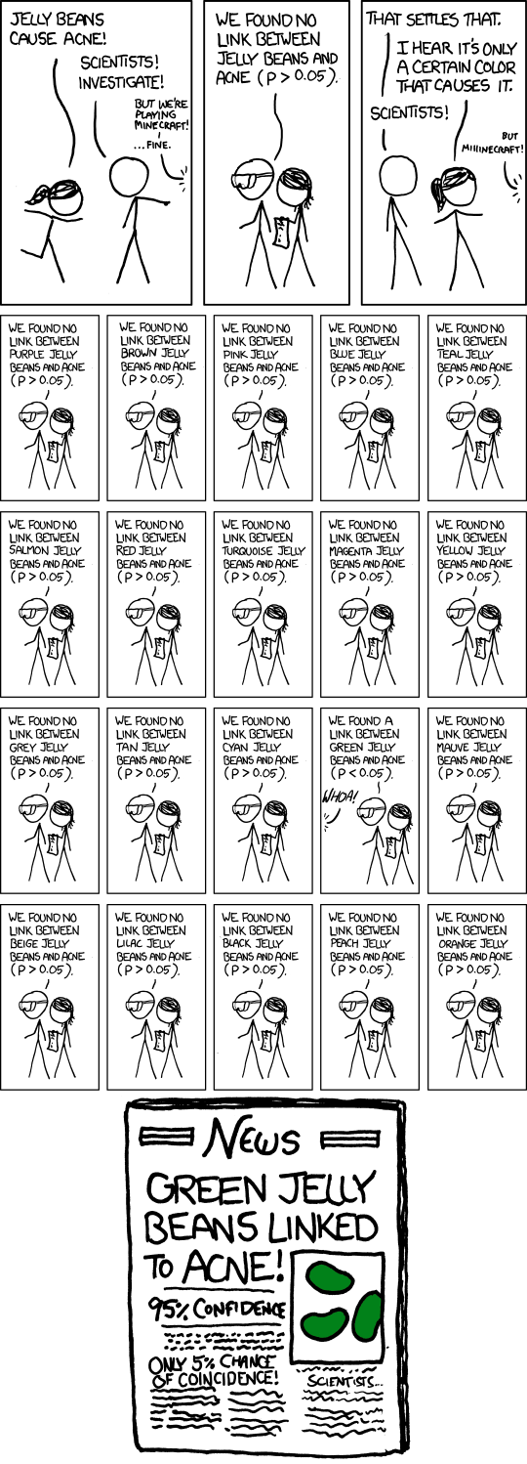
NEED Bonferroni correction for multiple tests

Slide 23
Hypothesis Testing Procedures
Many More Tests Exist!
Notes:
12

Slide 24
Parametric Test Procedures
1. Involve Population Parameters (Mean)
2. Have Stringent Assumptions
(Normality)
3. Examples: Z Test, t Test, χ² Test,
F test

Slide 25
Nonparametric Test Procedures
1. Do Not Involve Population Parameters
Example: Probability Distributions, Independence
2. Data Measured on Any Scale (Ratio or Interval, Ordinal or Nominal)
3. Example: Wilcoxon Rank Sum Test

Slide 26
Advantages of Nonparametric Tests
1. Used With All Scales
2. Easier to Compute
3. Make Fewer Assumptions
4. Need Not Involve Population Parameters
5. Results May Be as Exact
as Parametric Procedures
© 1984-1994 T/Maker Co.

Slide 27
Disadvantages of Nonparametric Tests
1.May Waste Information
Parametric model more efficient
if data Permit
2.Difficult to Compute by
hand for Large Samples
(But easy to compute ;-)
3.Less widely known
© 1984-1994 T/Maker Co.

Slide 28
Parametric tests-nonparametric equivalent
Paired t-test – Wilcoxon signed rank
Two sample t-test – Wilcoxon rank sum
ANOVA – Kruskal-Wallis test
When you have two or more independent samples and the assumptions of ANOVA are not met, you can use the Kruskal-Wallis test. This is a rank based test.

Slide 29
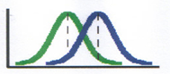
t-tests
comp
infer
12
10
95% CI
8
6
Left hemisphere
right hemisphere
Exp. 1 Exp. 2
lesion site
Compare the mean between 2 samples/ conditions
if 2 samples are taken from the same population, then they should have fairly similar means
⇨ if 2 means are statistically different, then the samples are likely to be drawn from 2 different populations, i.e., they really are different
Notes:
assesses whether the means of two samples are statistically different from each other. This analysis is appropriate whenever you want to compare the means of two samples/ conditions
mean
arithmetic average
a hypothetical value that can be calculated for a data set; it doesn’t have to be a value that is actually observed in the data set
calculated by adding up all scores and dividing them by number of scores
assumptions of a t-test:
from a parametric population
not (seriously) skewed
no outliers
independent samples

Slide 30
Formula
Difference between the means divided by the pooled standard error of the mean
Reporting convention: t= 11.456, df= 9, p< 0.001
Notes:
t-value+ an end product of a calculation
df = degrees of freedom (the number of individual scores that can vary without changing the sample mean)
Standard error
Is the standard deviation of sample means
It is a measure of how representative a sample is likely to be of the population
Large SE (relative to the sample mean): lots of variability between means of different samples ⇨ used sample may not be representative of a population
Small SE: most sample means are similar to the population mean ⇨ sample is likely to be an accurate reflection of the population

Slide 31
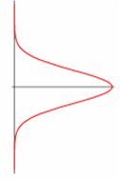
Formula cont.
Cond. 1
Cond. 2
Notes:
I admit I stole this from last year’s presentation: you may read this at your own leisure ☺
To calculate the t score,
Take mean from condition 1 (x bar)
Then the mean from condition 2
Find the difference between these two
And divide this by their shared standard error
Calculate this by…
Taking the variance for group 1 and dividing it by the sample size for this group
Do the same for group 2 and add together.
Then finally take the square root of this and put the resulting value back into the original calculation to get your t value.

Slide 32
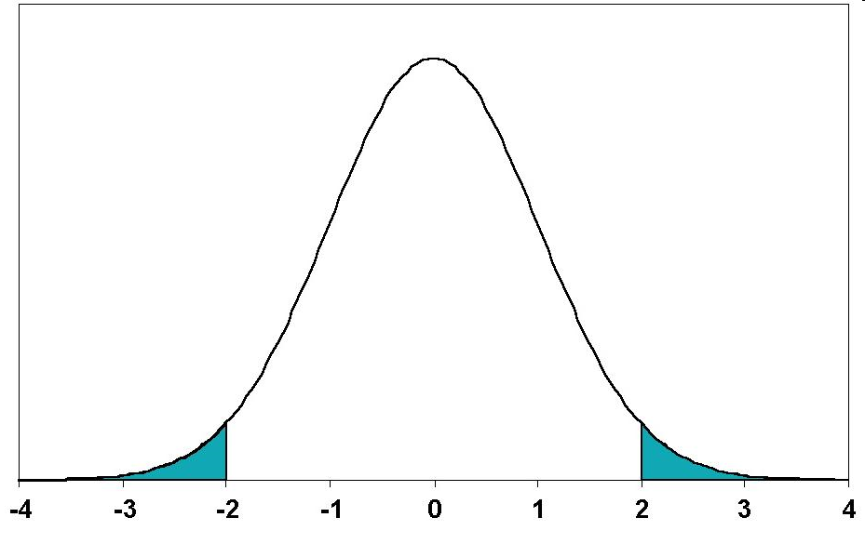


Types of t-tests cont.
2-tailed tests vs one-tailed tests
2 sample t-tests vs 1 sample t-tests
2.5%
2.5%
Mean
Mean
A known value
5%
Mean
Notes:
2-tailed tests vs one-tailed tests
If you set alpha-level at 0.05, there is 5% “area” in which a score would fall (outside where it is expected)
2-tailed tests leave room for this area to occur on both extreme ends, ie improvement may be either positive or negative (ie, 2,5% at either end)
One-tailed tests deny this and assume that the 5% can only occur at one extreme end (5%)
Both tails are meaningful in behavioural studies and should be favoured
2 sample t-tests vs 1 sample t-tests
2 sample t-tests compare the mean of 2 samples (both means are measured within the experiment)
1 sample t-tests compare the mean of one sample to a known value, often a (previously known) population mean
In fMRI: compare either 2 activation means of 2 different groups to each other or see if your one sample reaches a level of activation that you are expecting given some prior knowledge

Slide 33
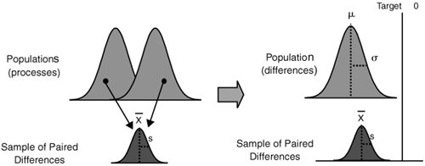
Why Paired Test

Slide 34

Types of t-tests
 | Independent Samples | Related Samples also called dependent means test
Interval measures/ parametric | Independent samples t-test* | Paired samples t-test**
Ordinal/ non-parametric | Mann-Whitney U-Test | Wilcoxon test
* 2 experimental conditions and different participants were assigned to each condition
** 2 experimental conditions and the same participants took part in both conditions of the experiments
Notes:
There are lots of different types of t-tests, which need to be used depending on the type of data you have
(equal) interval measures
Scales in which the difference between consecutive measuring points on the scale is of equal value throughout
No arbitrary zero, ie positive and negative measures, eg temperature
Ordinal measures
Scales on which the items can be ranked in order
There is an order of magnitude but intervals may vary, ie one item on the scale is more or less than another but it is not clear by how much as this cannot be measured
Often statements/ feelings are attached to numbers which can then be used for rating; in fact, this data can only be ranked (from highest to lowest) , ie what score had the highest turn-out
1= very good, 2= good, 3= neutral, 4= bad, 5= very bad
Different measurements have a direct influence on the way analysis is conducted because some of them are more amenable to mathematical operations than others

Slide 35
Excel: TTEST function
TTEST (array1, array2, tails, type)
array1 = the cell address for the first set of data
array2 = the cell address for the second set of data
tails: 1 = one-tailed, 2 = two-tailed
type: 1 = a paired t test; 2 = a two-sample test (independent with equal variances); 3 = a two-sample test with unequal variances

Slide 36
Excel: TTEST function
It does not compute the t value
It returns the likelihood that the resulting t value is due to chance (the possibility of the difference of two groups is due to chance)

Slide 37
Wilcoxon signed rank test
To test difference between paired data when data is not “normal” (guassian) e.g. it is ordinal (e.g. survey data)

Slide 38
STEP 1
Exclude any differences which are zero
Put the rest of differences in ascending order
Ignore their signs
Assign them ranks
If any differences are equal, average their ranks

Slide 39
STEP 2
Count up the ranks of +ives as T₊
Count up the ranks of –ives as T₋

Slide 40
STEP 3
If there is no difference between Treatment(T₊) and baseline (T₋), then T₊ & T₋ would be similar
If there were a difference
one sum would be much smaller and
the other much larger than expected
The smaller sum is denoted as T
T = smaller of T₊ and T₋

Slide 41
STEP 4
Compare the value obtained with the critical values (5%, 2% and 1% ) in appropriate table
N is the number of differences that were ranked (not the total number of differences)
So the zero differences are excluded

Slide 42
Subject | Hours of sleep |  | Difference | Rank Ignoring sign
 | Treatment | Baseline
1 | 6.1 | 5.2 | 0.9 | 3.5*
2 | 7.0 | 7.9 | -0.9 | 3.5*
3 | 8.2 | 3.9 | 4.3 | 10
4 | 7.6 | 4.7 | 2.9 | 7
5 | 6.5 | 5.3 | 1.2 | 5
6 | 8.4 | 5.4 | 3.0 | 8
7 | 6.9 | 4.2 | 2.7 | 6
8 | 6.7 | 6.1 | 0.6 | 2
9 | 7.4 | 3.8 | 3.6 | 9
10 | 5.8 | 6.3 | -0.5 | 1
3rd & 4th ranks are tied hence averaged
T= smaller of T₊ (50.5) and T₋ (4.5)
Here T=4.5 significant at 2% level indicating the Treatment is effective

Slide 43


Comparison of more than 2 Gruops
Tell me the difference between these groups…
Thank God I have ANOVA
Notes:
In an experiment with more than 2 samples or more than 2 tasks (or 2 samples and 2 tasks), one could do lots of t-tests and compare all the different groups with each other this way but actually you increase the possibility of falsely rejecting the null-hypothesis tremendously (this is referred to as familywise/ experimentwise error rate). It is much better to use ANOVA.

Slide 44
Multiple paired comparisons
Let a_{c} be the probability of an error in a single comparison
alpha = the probability of incorrectly rejecting null hypothesis
1-a_{c}: probability of making no error in a single comparison
(1-a_{c})^{m}: probability of no error in m comparisons (experiment)
a_{e} = 1-(1-a_{c})^{m}: probability of an error in the experiment
Under assumption of independent comparisons
a_{e} quickly becomes large as m increases

Slide 45
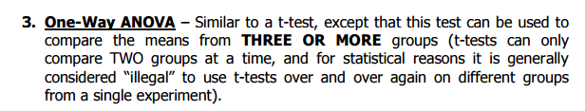
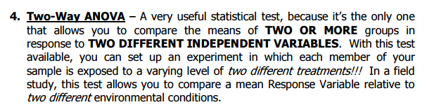

Slide 46
Types of analysis-independent samples
Outcome | Explanatory | Analysis
Continuous | Dichotomous | t-test, Wilcoxon test
Continuous | Categorical | ANOVA, linear regression
Continuous | Continuous | Correlation, linear regression
Dichotomous | Dichotomous | Chi-square test, logistic regression
Dichotomous | Continuous | Logistic regression
Time to event | Dichotomous | Log-rank test

Slide 47
Example
A recent study compared the hypointensity of gray matter structures on MRI in normal controls, benign MS patients and secondary progressive MS patients
Increased hypointensity is a marker of disease
Question: Is there any difference among these groups?

Slide 48
The null hypothesis is that all of the groups have the same hypointensity on average
Categorical predictor
Continuous outcome
You could compare each of the groups to each of the other groups which would be 3 pair wise comparisons at the 0.05 level, but what happens to the overall alpha level?
What is α?
α = P(reject H₀ | H₀ is true) so in this case α = P(one difference | all are equal )
Also, P(fail to reject H₀ | H₀ is true) = 1 - α

Slide 49
Overall α level
Now, if we completed each of the 3 pair wise tests at the 0.05 level and all of the tests were independent, P(fail to reject all 3 hypotheses | H₀ is true) = (1-0.05)³ = 0.857
Therefore, P(reject at least 1 | H₀ is true) = 1-0.857 = 0.143 = α = type I error
Type I error is greater than 0.05. This gets worse as number of comparisons increases
What can we do?
ANOVA

Slide 50
Analysis of variance (ANOVA)
Null hypothesis is μ₁=μ₂=...=μ_{n}
We are testing if the mean is equal across groups
The alternative hypothesis is that at least one of the means is different (but we will not be able to determine which one using this test)
The name tells us that we are going to be using the variance, but the goal is to use the variance to compare the means (this is a common source of confusion)

Slide 51
How does this work?
As with the t-test, we have a continuous outcome, but now we have multiple groups, which is a categorical variable
Before we begin, we must consider the assumptions required to use ANOVA
The underlying distributions of the populations are normal
The variance of each group is equal (This is critical for ANOVA), homoscedastic
These are similar to the two sample t-test

Slide 52
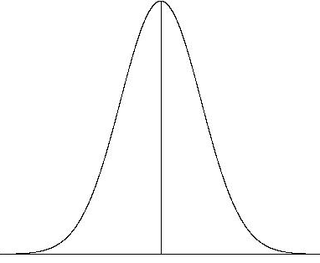
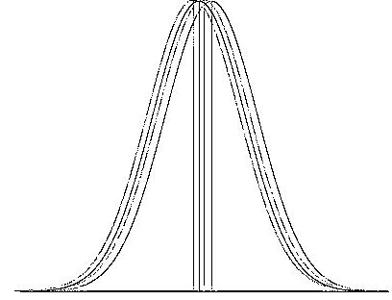
Picture
If all of the groups had the same means, the distributions for all of the populations would look exactly the same (overlaid graphs)

Slide 53
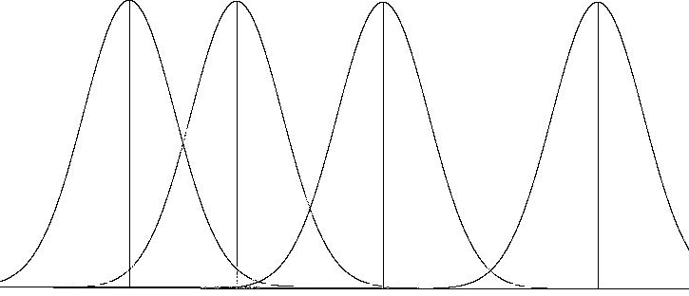
Picture II
Now, if the means of the populations were different, the picture would look like this. Notice that the variability between the groups is much greater than within a group

Slide 54
Sources of variance
When we take samples from each group, there will be two sources of variability
Within group variability - when we sample from a group there will be variability from person to person in the same group
Between group variability – the difference from group to group
If the between group variability is large, the means of the two groups are likely not the same

Slide 55
We can use the two types of variability to determine if the means are likely different
How can we do this?
Look again at the picture
Blue arrow: within group, red arrow: between group

Slide 56
Blue arrow: within group, red arrow: between group
Notice that when the distribution are separate, the between group variability is much greater than the within group

Slide 57
Notation
First we will define
How could we express the different forms of variability?
observation from student i from group j
mean of group j
grand mean over all of the groups

Slide 58
Sources of variability
The distance of each observation from the grand mean can be broken into two pieces
Like the calculation of the variance, we are interested in the square of the deviation
What does the squared deviation look like?
Within group variability
Between group variability

Slide 59
The final squared deviation simplifies to
As we discussed earlier, we are going to compare the two errors to determine if the group means are equal
Total sum of squares (SS_{T})
Within group sum of squares (SS_{W})
Between group sum of squares (SS_{B})

Slide 60
The within group variability can be written in terms of the individual group standard deviations, s_{i.}
The result is called the within group mean square error, which is the combined estimate of the within group variance
Note the denominator is the total sample size minus the number of groups

Slide 61
The between group variability can be broken into pieces from the summary statistics as well
The between group mean square error can be written as
The denominator of the MS_{B} is the number of groups minus 1 because we are considering the group means as the observations and the grand mean as the mean

Slide 62
F-statistic
Now that we have estimates of the between group and within group variation, we can use an F-statistic
where k is the number of groups and n is the total sample size
This test statistic is compared to an F-statistic with k-1 and n-k degrees of freedom

Slide 63
ANOVA table
To complete the analysis, we need to calculate the SS’s, MS’s and the F-statistic
A specific display of this data is often used called the ANOVA table
Standard software may provide results in this form
Source of variation | SS | df | MS | F | p-value
Between | SS_{B} | k-1 | MS_{B} | MS_{B}/MS_{W}
Within | SS_{W} | n-k | MS_{W}
Total | SS_{T}

Slide 64
Example
Let’s perform an ANOVA test for the hypointensity
Here are the summary statistics
 | Healthy | BMS | SPMS
Mean | 0.404 | 0.389 | 0.391
Standard deviation | 0.022 | 0.017 | 0.014
Sample size | 24 | 35 | 26

Slide 65
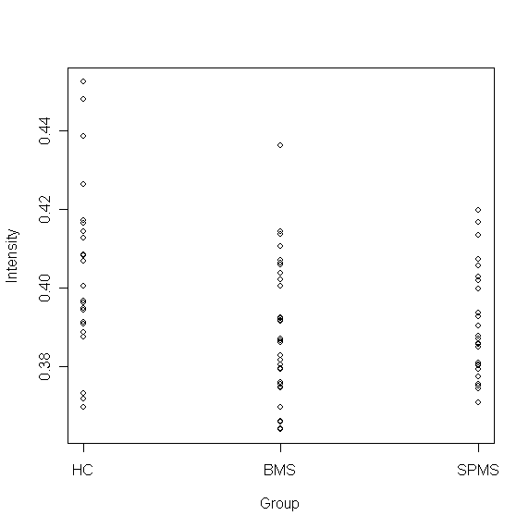

Slide 66
Hypothesis test
H₀: μ₁= μ₂= μ₃
Continuous outcome/categorical predictor
ANOVA
Test statistic: F=5.42
p-value=0.0062
Since the p-value is less than 0.05, we can reject the null hypothesis
We conclude that the mean is different in at least one group

Slide 67
ANOVA table
Here is the ANOVA table for this data
Source of variation | SS | df | MS | F | p-value
Between | 0.0035 | 2 | 0.0017 | 5.42 | 0.0062
Within | 0.026 | 82 | 0.00032
Total

Slide 68
An even smaller example
Suppose we have three groups
Group 1: 5.3, 6.0, 6.7
Group 2: 5.5, 6.2, 6.4, 5.7
Group 3: 7.5, 7.2, 7.9
We get the following statistics:

Slide 69
Computing ANOVA F statistic
overall mean: 6.44 F = 2.5528/0.25025 = 10.21575

Slide 70
Excel ANOVA Output
1 less than number of groups
number of data values - number of groups
(equals df for each group added together)
1 less than number of individuals
(just like other situations)

Slide 71
Notes
Remember the assumption of normality of data and equal variance across groups is required
We were able to conclude that one of the means is different, but we do not know which of the means is different. ANOVA is often considered a first step
We can do pair wise comparisons to determine which specific means are different, but we must still take into account the problem with multiple comparisons

Slide 72
Bonferroni correction
The simplest way to handle the multiple comparisons is to correct the alpha level to allow the overall alpha level to be closer to the desired 0.05 level
The Bonferroni correction takes the observed p-values and multiplies it by the number of comparisons
If we have 3 groups and we would like to complete all pair wise comparison, we multiply the p-values by 3
In addition, we assume that the variance is equal in the pairwise t-tests

Slide 73
Multiple testing
Say that you perform a statistical test with a 0.05 threshold, but you repeat the test on twenty different observations. Assuming that all of the observations are explainable by the null hypothesis, what is the chance that at least one of the observations will receive a p-value less than 0.05?
Pr(making a mistake) = 0.05
Pr(not making a mistake) = 0.95
Pr(not making any mistake) = 0.95²⁰ = 0.358
Pr(making at least one mistake) = 1 - 0.358 = 0.642
There is a 64.2% chance of making at least one mistake.

Slide 74
Pairwise t-test
Here are the pairwise t-test results
Group 1 | Group 2 | p-value | Adjusted p-value
HC | BMS | 0.0022 | 0.0065
HC | SPMS | 0.014 | 0.042
BMS | SPMS | 0.62 | 1.0
We conclude that there is a significant difference between the healthy controls and both groups of MS patients, but no difference between the two groups of MS patients

Slide 75
More on Bonferroni correction
For three groups, we have three pairwise comparisons
What if we were only interested in comparing each MS group to the healthy controls? How many comparisons would we need to correct for?
Two comparisons
Multiply each p-value by 2

Slide 76
What is the
Bonferroni correction?

Slide 77
Bonferroni correction
Assume that individual tests are independent. (Is this a reasonable assumption?)
Divide the desired p-value threshold by the number of tests performed.
For the previous example, 0.05 / 20 = 0.0025.
Pr(making a mistake) = 0.0025
Pr(not making a mistake) = 0.9975
Pr(not making any mistake) = 0.9975²⁰ = 0.9512
Pr(making at least one mistake) = 1 - 0.9512 = 0.0488

Slide 78
Type I and Type II Errors
Definition: A Type I error (α) corresponds to the error of rejecting H0, the null hypothesis, when it is, in fact, true. A Type II error (β) corresponds to the error of failing to reject H0 when it is false.
Definition: The power of a test is the probability of rejecting H0 given that it is false. Power = 1- β

Slide 79
Why does Power Matter? I
All the hypothesis tests described in the previous three sections are only concerned about reducing the Type I error.
i.e., they try to ascertain the conditions under which we are rejecting a hypothesis rightly.
They are not at all concerned about the case where the null hypothesis is really false, but we do not reject it.

Slide 80
Why does Power Matter? II
In the case of Machine Learning, reducing the type I error means reducing the probability of us saying that there is a difference in the performance of the 2 classifiers, when in fact, there isn’t.
Reducing the type II error means reducing the probability of us saying that there is no difference in the performance of the two classifiers, when, in fact, there is.
Power matters because we do not want to discard a classifier that shouldn’t have been discarded. If a test does not have enough power, then this kind of situation can arise

Slide 81
What is the Effect Size?
The effect size measures how strong the relationship between two entities is.
In particular, if we consider a particular procedure, in addition to knowing how statistically significant the effect of that procedure is, we may want to know what the size of this effect is.
There are different measures of effect sizes, including:
Pearsons’ correlation coefficient
Odd’s ratio
Cohen’s d statistics
Cohen's d statistic is appropriate in the context of a t-test on means. It is thus the effect size measure we concentrate on here.
[Wikipedia: http://en.wikipedia.org/wiki/Effect_size]

Slide 82
Cohen’s d-statistics
Cohen’s d-statistic is expressed as:
d = (X1 – X2)/ sp
Where sp², the pooled variance estimate is:
sp²= ((n1-1)*s₁² + (n2-1)*s₂²)
(n1+n2-2)
and sp, its square root.
[Note this is not exactly Cohen’s d measure which os expressed in terms of parameters. This is a very usable estimate of d].

Slide 83
Usefulness of the d statistic
d is useful in that it standardizes the difference between the two means. We can talk about deviations in terms of proportions of standard deviation points that are more useful than actual differences that are domain dependent.
Cohen came up with a set of guidelines concerning d:
d=.2 has a small effect, but is probably meaningful;
d= .5 is a medium effect that is noticeable.
d= .8 shows a large effect size.

Slide 84
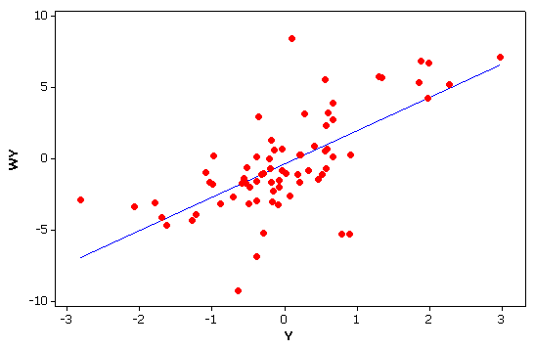
Bivariate and Multivariate
All measures so far have focused on one variable at a time
univariate
Often, we are interested in the association or relationship between two variables
bivariate.
Or more than two variables
multivariate
income
education
Y
income
gender*
education
X₁
X₂
*Gender = male or female

Slide 85
Correlation and Regression The most commonly used techniques in science.
Review standard (non-spatial) approaches
Correlation
Regression

Slide 86
Correlation and Regression What is the difference?
Mathematically, they are identical.
Conceptually, very different.
Correlation
Co-variation
Relationship or association
No direction or causation is implied
Y X X₁ X₂
Regression
Prediction of Y from X
Implies, but does not prove, causation
X (independent variable) Y (dependent variable)
Regression line
predicts

Slide 87
Correlation Coefficient (r)
The most common statistic in all of science
measures the strength of the relationship (or “association”) between two variables e.g. income and education
Varies on a scale from –1 thru 0 to +1
+1 implies a perfect positive association
As values go up (⬆) on one, they also go up (⬆) on the other
income and education
0 implies no association
-1 implies perfect negative association
As values go up on one (⬆) , they go down (⬇) on the other
price and quantity purchased
Formal Full name is the Pearson Product Moment correlation coefficient,
(⬆) (⬇)
(⬆) (⬆)
-1
0
+1

Slide 88
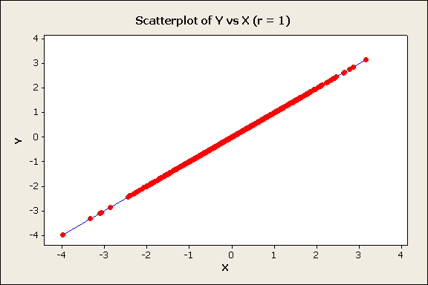
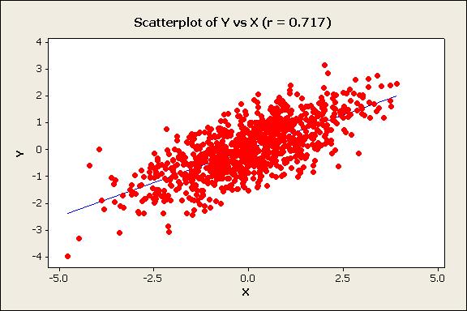
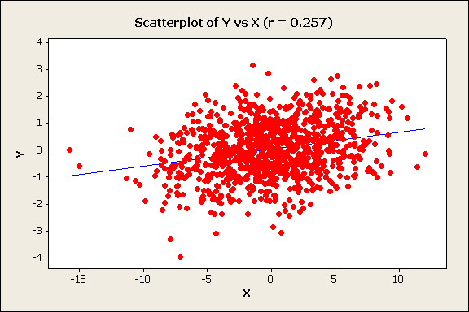
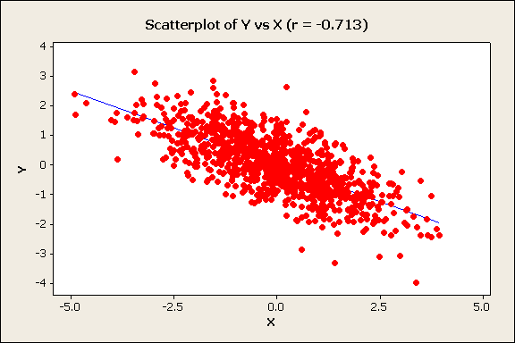
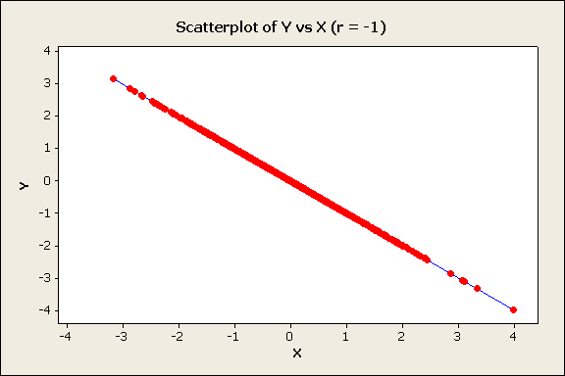
Examples of Scatter Diagrams and the Correlation Coefficient
Positive
r = 1
r = 0.72
r = 0.26
perfect
positive
Income
strong
positive
weak
positive
Education
Negative
r = -0.71
r = -1
Quantity
strong
negative
perfect
negative
Price

Slide 89
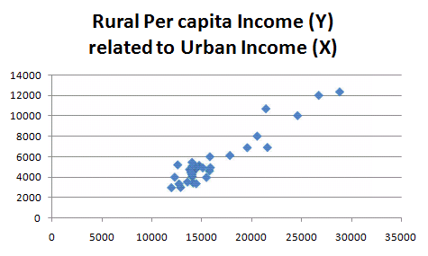
Correlation Coefficient: example
Correlation coefficient
= 0.9458
China Provinces 29
excludes Xizang/Tibet, Macao, Hong Kong, Hainan, Taiwan, P'eng-hu

Slide 90
Calculation Formulae for Correlation Coefficient (r)
Before the days of computers, these formulae where easier to do “by hand.”
See next slide for example

Slide 91
Regression
Simple regression
Between two variables
One dependent variable (Y)
One independent variable (X)
Multiple Regression
Between three or more variables
One dependent variable (Y)
Two or independent variable (X₁ ,X_{2…})
Y
X
Y
income
gender*
education
X₁
X₂

Slide 92
Simple Linear Regression
Concerned with “predicting” one variable (Y - the dependent variable) from another variable (X - the independent variable)
Y = a +bX +ε
ε = residual= error = Y_{i}-Ŷ_{i} =Actual (Y_{i} ) – Predicted (Ŷ_{i} )
a is the intercept —the value of Y when X =0
b is the regression coefficient or slope of the line
—the change in Y for a one unit change in X
Y_{i}
Y
Regression line
Ŷ_{i}
b
1
a
X
0

Slide 93
Ordinary Least Squares (OLS) --the standard criteria for obtaining the regression line
The regression line minimizes the sum of the squared deviations between actual Y_{i} and predicted Ŷ_{i}
Y_{i}
Ŷ_{i}
Min ∑(Y_{i}-Ŷ_{i})²
Y_{i}
Ŷ_{i}

Slide 94
Coefficient of Determination (r²)
The coefficient of determination (r²) measures the proportion of the variance in Y (the dependent variable) which can be predicted or “explained by” X (the independent variable). Varies from 1 to 0.
It equals the correlation coefficient (r) squared.
SS Regression or Explained Sum of Squares
SS Total or Total Sum of Squares
Note:
SS Total or Total Sum of Squares
SS Regression or Explained Sum of Squares
SS Residual or Error Sum of Squares
=
+

Slide 95
Partitioning the Variance on Y
Y
Y
Y
SS Total
or Total Sum of Squares
SS Regression
or Explained Sum of Squares
SS Residual
or Error Sum of Squares

Slide 96
Standard Error of the Estimate (s_{e})
Measures predictive accuracy: the bigger the standard error, the greater the spread of the observations about the regression line, thus the predictions are less accurate
S_{e}² = error mean square, or average squared residual
= variance of the estimate, variance about regression
Sum of squared residuals
Number of observations minus degrees of freedom
(for simple regression, degrees of freedom = 2)

Slide 97
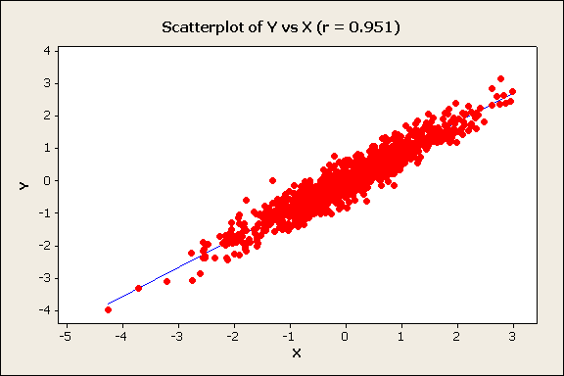
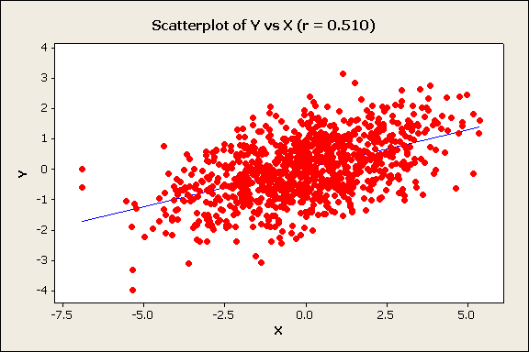
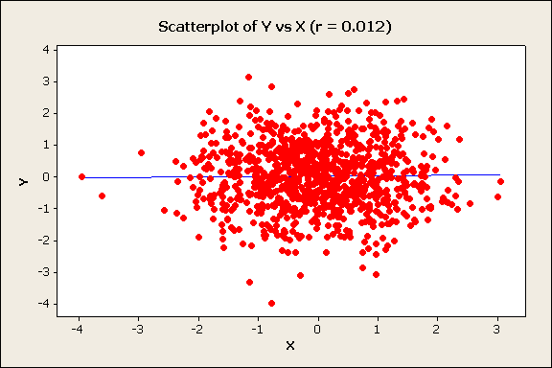
Coefficient of determination (r² ), correlation coefficinet (r), regression coefficient (b), and standard error (S_{e})
(Values are hypothetical and for illustration of relative change only)
r² = 0.94 r = .97
S_{e}= 0.3
r² = r = 1
S_{e}= 0.0
S_{y} = 2
b = 2
r² = 0.51 r = .71
S_{e}= 1.1
b = 1.1
perfect
positive
Very strong
strong
r² = 0.26 r = .51
S_{e}= 1.3
b = 0.8
r² = 0.07
S_{e}= 1.8
b = 0.1
r² = r= 0.00
S_{e}= S_{y} = 2
moderate
weak
b = 0
none
Regression
line in
blue
As the coefficient of determination gets smaller, the slope of the regression line (b) gets closer to zero.
As the coefficient of determination gets smaller, the standard error gets larger, and closer to the standard deviation of the dependent variable (Y) (S_{y} = 2)

Slide 98
Sample Statistics, Population Parameters and Statistical Significance tests
Y_{i} = a +bX_{i} +ε_{i} a and b are sample statistics
which are estimates of
population parameters α and β
β (and b) measure the change in Y for a one unit change in X. If β = 0 then X has no effect on Y, therefore
Null Hypothesis (H₀): in the population β = 0
Alternative Hypothesis (H₁): in the population β ≠ 0
Thus, we test if our sample regression coefficient, b, is sufficiently different from zero to reject the Null Hypothesis and conclude that X has a statistically significant affect on Y

Slide 99
Test Statistics in Simple Regression
Test statistic for b is distributed according to the Student’s t Distribution (similar to normal):
where is the variance of the estimate,
with degrees of freedom = n – 2
A test can also be conducted on the coefficient of determination (r² ) to test if it is significantly greater than zero, using the F frequency distribution.
It is mathematically identical to the t test.

Slide 100
Multiple regression
Y
We can rewrite simple regression as:
income
gender*
education
X₁
X₂
Multiple regression: Y is predicted from 2 or more independent variables
β₀ is the intercept —the value of Y when values of all X_{j} = 0
β₁… β _{m} are partial regression coefficients which give the change in Y for a one unit change in X_{j}, all other X variables held constant
m is the number of independent variables

Slide 101
Multiple regression: least squares criteria
or
As in simple regression, the “least squares” criteria is used. Regression coefficients b_{j} are chosen to minimize the sum of the squared residuals (the deviations between actual Y_{i} and predicted Ŷ_{i})
The difference is that Ŷ_{i} is predicted from 2 or more independent variables, not one.
Regression
hyperplane

Slide 102
Coefficient of Multiple Determination (R²)
Similar to simple regression, the coefficient of multiple determination (R²) measures the proportion of the variance in Y (the dependent variable) which can be predicted or “explained by” all of X variables in combination.
Varies from 0 to 1.
Formulae identical to simple regression
SS Regression or Explained Sum of Squares
SS Total or Total Sum of Squares
As with simple regression
SS Total or Total Sum of Squares
SS Regression or Explained Sum of Squares
SS Residual or Error Sum of Squares
=
+

Slide 103
Reduced or Adjusted
R² will always increase each time another independent variable is included
an additional dimension is available
for fitting the regression hyperplane
(the multiple regression equivalent
of the regression line)
Adjusted is normally used instead of R² in multiple regression
Not perfect
Y
perfect
X₁
X₂
k is the number of coefficients in the regression equation, normally equal to the number of independent variables plus 1 for the intercept.

Slide 104
Interpreting partial regression coefficients
The regression coefficients (b_{j}) tell us the change in Y for a 1 unit change in X_{j}, all other X variables “held constant”
Can we compare these b_{j} values to tell us the relative importance of the independent variables in affecting the dependent variable?
If b₁ = 2 and b₂ = 4, is the affect of X₂ twice as big as the affect of X₁ ?
No, no, no in general!!!!
The size of b_{j} depends on the measurement scale used for each independent variable
if X₁ is income, then a 1 unit change is $1
but if X₂ is rmb or Euro(€) or even cents (₵)
1 unit is not the same!
And if X₂ is % population urban, 1 unit is very different
Regression coefficients are only directly comparable if the units are all the same: all $ for example
Y
b
a
1
X

Slide 105
Standardized partial regression coefficients Comparing the Importance of Independent Variables
How do we compare the relative importance of independent variables?
We know we cannot use partial regression coefficients to directly compare independent variables unless they are all measured on the same scale
However, we can use standardized partial regression coefficients (also called beta weights, beta coefficients, or path coefficients).
They tell us the number of standard deviation (SD) unit changes in Y for a one SD change in X)
They are the partial regression coefficients if we had measured every variable in standardized form
Note the confusing use of β for both standardized partial regression coefficients and for the population parameter they estimate.

Slide 106
Test Statistics in Multiple Regression: testing each independent variable
A test can be conducted for each partial regression coefficient b_{j} to test if the associated independent variable influences the dependent variable. It is distributed according to the Student’s t Distribution (similar to the normal frequency distribution):
Null Hypothesis H_{o} : b_{j} = 0
.
with degrees of freedom = n – k, where k is the number of coefficients in the regression equation, normally equal to the number of independent variables plus 1 for the intercept (m+1).
The formula for calculating the standard error (SE) of b_{j} is more complex than for simple regression , so it is not shown here.

Slide 107
Test Statistics in Multiple Regression testing the overall model
We test the coefficient of multiple determination (R² ) to see if it is significantly greater than zero, using the F frequency distribution.
It is an overall test to see if at least one independent variable, or two or more in combination, affect the dependent variable.
Does not test if each and every independent variable has an effect
Similar to the F test in simple regression.
But unlike simple regression, it is not identical to the t tests.
It is possible (but unusual) for the F test to be significant but all t tests not significant.
Again, k is the number of coefficients in the regression equation, normally equal to the number of variables (m) plus 1.

Slide 108
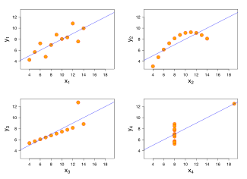
Always look at your data
Don’t just rely on the statistics!
Anscombe's quartet Summary statistics are the same for all four data sets:
mean (7.5),
standard deviation (4.12), correlation (0.816) regression line
(y = 3 + 0.5x).
Anscombe, Francis J. (1973). "Graphs in statistical analysis". The American Statistician 27: 17–21.

Slide 109
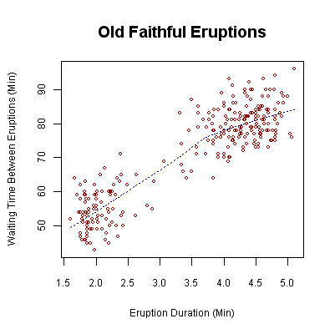
Real data is almost always more complex than the simple, straight line relationship assumed in regression.
Waiting time between eruptions and the duration of the eruption for the Old Faithful Geyser in Yellowstone National Park, Wyoming, USA. This chart suggests there are generally two "types" of eruptions: short-wait-short-duration, and long-wait-long-duration.
Source: Wikipedia

Slide 110


Beware Spurious relationships
Eating ice cream inhibits swimming ability.
--eat too much, you cannot swim
Omitted variable problem
--both are related to a third variable not included in the analysis
Help!
Summer temperatures:
--more people swim
(and some drown)
--more ice cream is sold

Slide 111
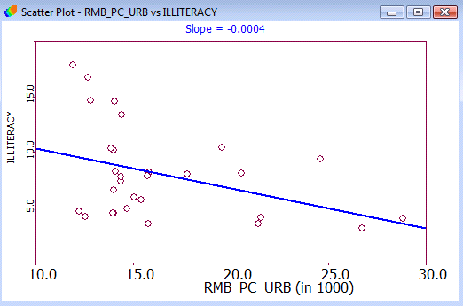
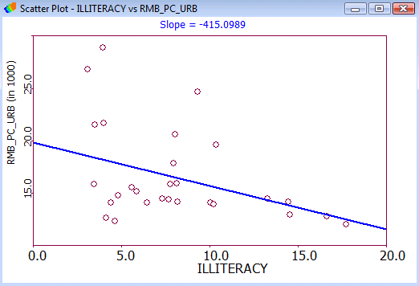
Regression does not prove direction or cause! Income and Illiteracy
Provinces with higher incomes can afford to spend more on education, so illiteracy is lower
Higher Income>>>>Less Illiteracy
The higher the level of literacy (and thus the lower the level of illiteracy) the more high income jobs.
Less Illiteracy>>>>Higher Income
Regression will not decide!
Illiteracy
Income
Income
Illiteracy

Slide 112
What if there is not enough data?
Bootstrap
Jackknife
Cross-validation

Slide 113
What is Bootstrap
Bootstrapping is a method for estimating the sampling distribution of an estimator by resampling with replacement from the original sample.
The bootstrap procedure is a means of estimating the statistical accuracy . . . from the data in a single sample.
Bootstrapping is used to mimic the process of selecting many samples when the population is too small to do otherwise
The samples are generated from the data in the original sample by copying it many number of times (Monte Carlo Simulation)
Samples can then selected at random and descriptive statistics calculated or regressions run for each sample
The results generated from the bootstrap samples can be treated as if it they were the result of actual sampling from the original population

Slide 114
Characteristics of Bootstrapping
Full Sample
Sampling with Replacement

Slide 115
Bootstrapping Example
Random sampling with replacement can be employed to create multiple independent samples for analysis
Limited number of observations
Original Data Set
1st Random Sample
Pittsburgh
Navy
Michigan
Ohio State
Michigan State
USC
Washington
Washington
Purdue
10⁹ Copies of each observation
Ohio State
USC
USC
BYU
BYU
Tennessee
Stanford
Navy
Pittsburgh
Syracuse
Creating a much larger sample with which to work
Ohio State
Stanford
Stanford
Ohio State
Michigan

Slide 116
When it should be used
Bootstrapping is especially useful in situations when no analytic formula for the sampling distribution is available.
Traditional forecasting methods, like exponential smoothing, work well when demand is constant – patterns easily recognized by software
In contrast, when demand is irregular, patterns may be difficult to recognize.
Therefore, when faced with irregular demand, bootstrapping may be used to provide more accurate forecasts, making some important assumptions…

Slide 117
Assumptions and Methodology
Bootstrapping makes minimal assumption regarding the population (does need full independence)
No normality of error terms
No equal variance
Allows for accurate forecasts of intermittent demand
If the sample is a good approximation of the population, the sampling distribution may be estimated by generating a large number of new samples
For small data sets, taking a small representative sample of the data and replicating it will yield good results. If not representative it will exaggerate bais

Slide 118
Application and Uses
Setting Parameters
Agilent Technologies determined it was time to transfer manufacturing of its 3070 in-circuit test systems from Colorado to Singapore
Major concern was the change in environmental test conditions (dry vs humid)
Because Agilent tests to tighter factory limits (“guard banding”), they needed to adjust the guard band for Singapore
Bootstrap was used to determine the appropriate guard band for Singapore facility

Slide 119
Variations
Bayesian Bootstrap
Block Bootstrap
Stratified Block Resampling bootstrap
Case resampling
Bias-Corrected Bootstrap
Gaussian process regression bootstrap
Resampling residuals

Slide 120
An Alternative to the bootstrap
Jackknife
A statistical method for estimating and removing bias* and for deriving robust estimates of standard errors and confidence intervals
Created by systematically dropping out subsets of data one at a time and assessing the resulting variation
Bias: A statistical sampling or testing error caused by systematically favoring some outcomes over others

Slide 121
A comparison of the Bootstrap & Jackknife
Bootstrap
Yields slightly different results when repeated on the same data (when estimating the standard error)
Not bound to theoretical distributions
Jackknife
Less general technique
Explores sample variation differently
Yields the same result each time
Similar data requirements

Slide 122
Cross-Validation
Another alternative method
The practice of partitioning data into a sample of data into sub-samples such that the initial analysis is conducted on a single sub-sample (training data), while further sub-samples (test or validation data) are retained “blind” in order for subsequent use in confirming and validating the initial analysis

Slide 125
Bootstrap vs. Cross-Validation
Bootstrap
Requires a small of data
More complex technique – time consuming
Cross-Validation
Not a resampling technique
Requires large amounts of data
Extremely useful in data mining and artificial intelligence

Slide 127
